Slide 1
K Nearest Neighbor
Lecture

Slide 2
Table of Content
Libraries
Editing CSV files using Pandas Library
Calculating Euclidean Distance
KNN programming through SKLearn Library

Slide 3
Libraries
math
Pandas
Numpy
SKLearn
MatPlotlib
Seaborn

Slide 4

Editing CSV files using Pandas Library
Importing a CSV file into the DataFrame
https://pandas.pydata.org/pandas-docs/stable/reference/api/pandas.read_csv.html

Slide 5
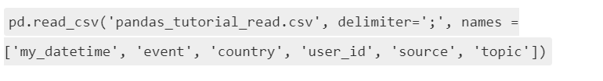
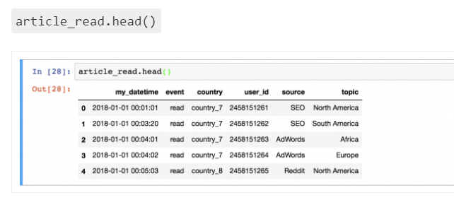
Editing CSV files using Pandas Library
head() method gives top 5 rows in the datafram
info()
describe()

Slide 6
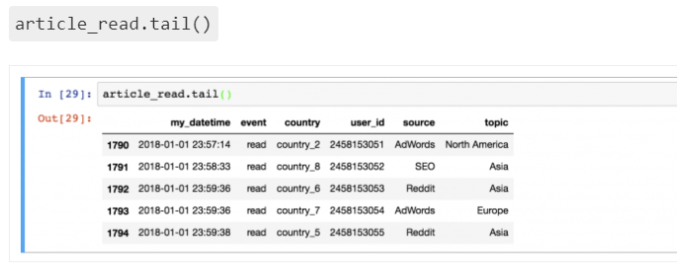
Editing CSV files using Pandas Library
tail() method gives bottom 5 rows in the dataframe
https://pandas.pydata.org/pandas-docs/stable/reference/frame.html

Slide 7
Editing CSV files using Pandas Library
df[['Feature1', 'Feature2']] - This would print specific columns mentioned in the [ ] brackets
df.Feature2 == 3.0 - This would check the entire column and print true or false if the value indeed matches the text 3.0
df[df.Feature2 == 3.0] - This will fetch the records which matches the text 3.0
df.head()[['Feature1', 'Feature2']] - This line first selects the first 5 rows of our data set. And then it takes only the 'Feature1'and the 'Feature2' columns.

Slide 8
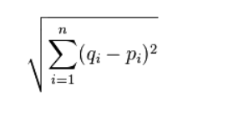
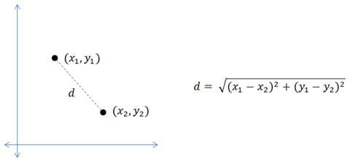
Calculating Euclidean Distance

Slide 9
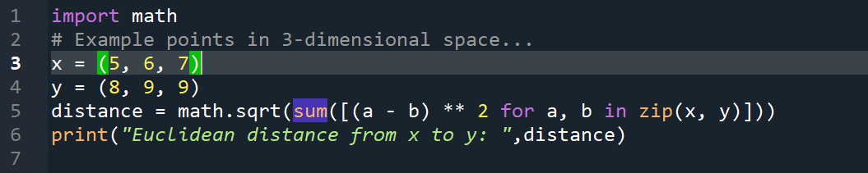
Calculating Euclidean Distance

Slide 10
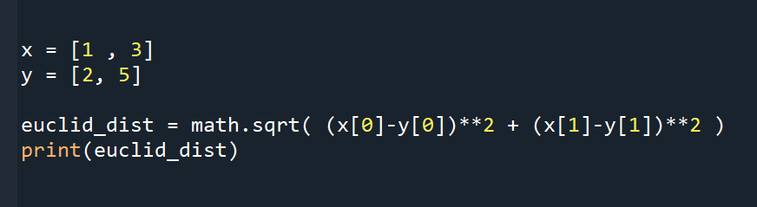
Calculating Euclidean Distance

Slide 11
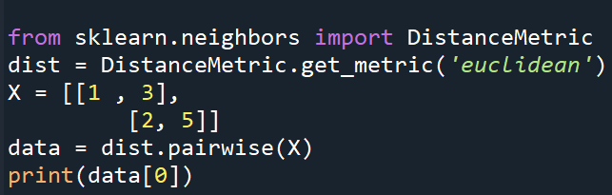
Calculating Euclidean Distance

Slide 12
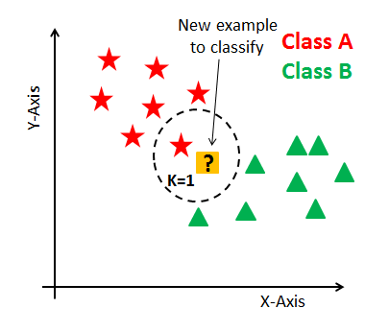
KNN Means programming through SKLearn Library
How does the KNN algorithm work?
In KNN, K is the number of nearest neighbors. The number of neighbors is the core deciding factor. K is generally an odd number if the number of classes is 2. When K=1, then the algorithm is known as the nearest neighbor algorithm. This is the simplest case. Suppose P1 is the point, for which label needs to predict. First, you find the one closest point to P1 and then the label of the nearest point assigned to P1.

Slide 13
KNN Means programming through SKLearn Library
Suppose P1 is the point, for which label needs to predict. First, you find the k closest point to P1 and then classify points by majority vote of its k neighbors. Each object votes for their class and the class with the most votes is taken as the prediction. For finding closest similar points, you find the distance between points using distance measures such as Euclidean distance, Hamming distance, Manhattan distance and Minkowski distance. KNN has the following basic steps:

Slide 14
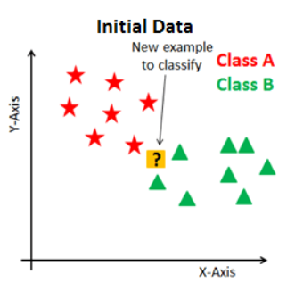
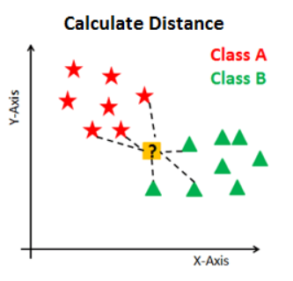
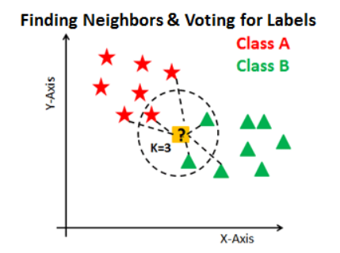
KNN Means programming through SKLearn Library

Slide 15
KNN Means programming through SKLearn Library
Importing Libraries
import numpy as np
import pandas as pd
from sklearn.model_selection import train_test_split
from sklearn.neighbors import KNeighborsClassifier

Slide 16
KNN Means programming through SKLearn Library
Loading and Slicing DataFrame
url = "https://archive.ics.uci.edu/ml/machine-learning-databases/iris/iris.data"
dataset = pd.read_csv(url)
dataset.head()
df_x = dataset.iloc[:, :-1].values
df_y = dataset.iloc[:, 4].values

Slide 17
KNN Means programming through SKLearn Library
Splitting into DataSets
X_train, X_test, y_train, y_test = train_test_split(df_x, df_y, test_size=0.20)
classifier = KNeighborsClassifier(n_neighbors=5)
classifier.fit(X_train, y_train)

Slide 18
KNN Means programming through SKLearn Library
Training and Predicting
classifier = KNeighborsClassifier(n_neighbors=5)
classifier.fit(X_train, y_train)
y_pred = classifier.predict(X_test)
print(y_test[0:5])
print(y_pred[0:5])

Slide 19
Links to Refer
- https://www.w3resource.com/python-exercises/pandas/index.php (for pandas practice)
- https://scikit-learn.org/stable/modules/generated/sklearn.neighbors.DistanceMetric.html (SKLearn Library documentation)
- https://www.programiz.com/python-programming/methods/built-in/abs (For learning python built-in methods)
- https://www.datacamp.com/community/tutorials/python-tuples-tutorial (for learning about Tuples)
- Programiz (search for python lists)

